Slide 1
Ruby on Rails
Week 3
Model View Controllers in Action

Slide 2
Terms
REST:
MVC in Rails is aided by Representation State Transfer (REST).
REST is the convention for routing in Rails.
Routing refers to how requests are routed within the application itself.

Slide 3
Assets
Is a directory for static assets of the application, such as JavaScript, Images, CSS etc..

Slide 4
Helpers
Are small snippets of code that can be called from your VIEWS
Any code that is used regularly can most likely be moved into a helper.
It can be used across your entire application.
Helpers can be though of like functions / methods.

Slide 5
Mailers
In order to use e-mails in Rails, mailers must be created.
Mailers are stored in the app\mailers
Mailers inherit from ActionMailer::Base
Mailers have associated views that appear alongside controller view in app/views.

Slide 6
Model-View-Controller
Ruby on Rails organises application files into Three main directories: Model, View and Controller.
In software development, this is known as the Model-View-Controller architecture / design pattern.
Originally used in implementing user interfaces in desktop computers
Commonly used in Mobile App Development, Android and iOS.

Slide 7
Model-View-Controller
Browser Sends Request;
Web server receives the request and passes it on to a controller.
If the request requires data, the controller communicates with a model, which is in charge of the CRUD operations, before rendering the required view.
In software development, this is known as the Model-View-Controller architecture / design pattern.
Originally used in implementing user interfaces in desktop computers
Commonly used in Mobile App Development, Android and iOS.
Notes:
Rendering: A process of converting templates and layouts into HTML page

Slide 8
Model-View-Controller (The benefits)
Increases Code Reusability
Model can be reused by multiple views and vice versa.
Improves Scalability
You can upgrade the hardware running the database without affecting other components.
Simplifies Maintenance
Components have low dependency on each other, meaning changes to one does not affect another.
You can change a database that feeds an application, without changing the applicaton.
Notes:
Rendering: A process of converting templates and layouts into HTML page

Slide 9
Model
It represents data of an application and the rules to manipulate it
Think of Models as Ruby objects (similar to Java)
Responsible for performing the business logic.
Validation, association, transactions etc…
Maintains relationship with the database.
In most cases, each table in your DB will correspond to one model in your application.
Notes:
Rendering: A process of converting templates and layouts into HTML page

Slide 10
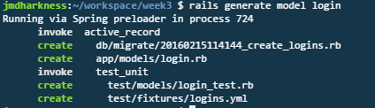
Generating a Model
Use the “generate” script
Pass “model” as an object to be created
Pass the name of the model you want created
Notes:
Rendering: A process of converting templates and layouts into HTML page

Slide 11
View
User friendly representation of the application data.
The process of created a view is called rendering
It is a process of converting templates and layouts to create an html page.
Templates are files stored in the app/views that represent static information about the view.
Layouts are files stored in the app/views/layouts that specify physical appearances of web pages.
It is a common practice for a Web application to have more than one layout. A layout of an index page and login page for instance tend to be different.
Notes:
Rendering: A process of converting templates and layouts into HTML page

Slide 12
Controller
It is responsible for processing a client (browser) request and producing appropriate output (html page)
Middle man between models and views.
A web server uses routing to identify appropriate controllers and actions for a browser requests
It then creates an instance of the controller and runs the method with the same name as the action.
Notes:
Rendering: A process of converting templates and layouts into HTML page

Slide 13
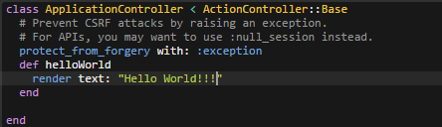
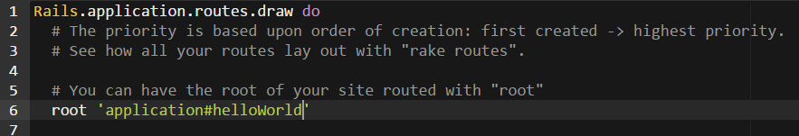
Example from Last Week.
Controller
Routes
Notes:
Rendering: A process of converting templates and layouts into HTML page

Slide 14
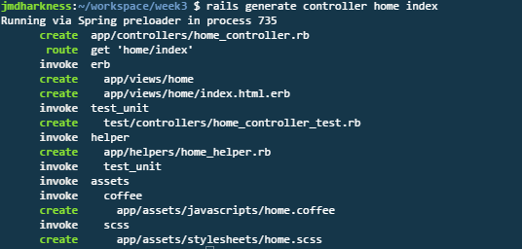
MVC in Action
Rails enables you to generate both a controller and a view using a single command.
$rails generate controller home index
Notes:
Rendering: A process of converting templates and layouts into HTML page

Slide 15
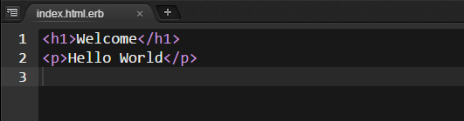
MVC in Action
You can edit your generated “view” by navigating to the file of view name under: app/views/home
Notes:
Rendering: A process of converting templates and layouts into HTML page

Slide 16
Practical Q1
Login to Cloud9
Create a new Project called Week3Q1
Generate a new controller and view.
Modify the view so that it displays some a Custom Greeting.
Add this to you version control (GIT)
Publish to Heroku (remember the GEM File)

Slide 17

Scaffolding
Scaffolds in Rails provide a lot of basic functionality and are generally used as a temporary structure to get started.
We use the generate argument to the rails command followed by what it is to generate, i.e scaffold.
Scaffold generates:
Models
Controller
Views
Tests

Slide 18
Scaffolding
Everything after the name for the scaffold are the fields for the database table and the attributes for the objects of this scaffold.
The above examples states:
The table for your purchase scaffold will contain a name and cost field, which are a string and a float, respectively.
To create this table, the scaffold generator generates what’s known as a migration

Slide 19
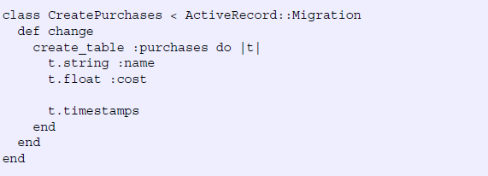

Migrations
Migrations are a form of version control for DBs.
Provides way to implement incremental changes to the schema of a DB.
Each migration is Time Stamped to the second.
To run migration, we type he following command:
Notes:
Each migration is timestamped right down to the second, which provides you (and anybody else developing the application with you) an accurate timeline of your database. When two developers are working on separate features of an application and both generate a new migration, this timestamp will stop them from clashing. Let’s open the only file in db/migrate now and see what it does. Its contents are shown in the following listing.
Migrations are Ruby classes that inherit from ActiveRecord::Migration. Inside the class, one method is defined: the change method.
Inside the change method, you use database-agnostic commands to create a table. When this migration is run forward, it will create a table called "purchases", with a "name" column that's a string, a "cost" column that's a float , and two timestamp fields.

Slide 20
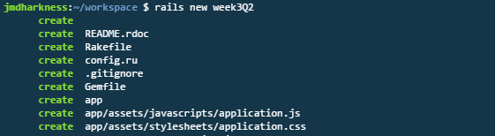
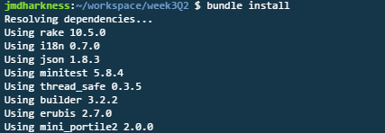
Blog Example – Create new App
Create new App called Week3Q2:
Edit GEM file to the one on moodle.
Run bundle install.

Slide 21
Blog Example – Model Design
Put under version control using GIT and BitBucket.
We are going to generate some DB tables to hold both User information and Blog Post Entries. What fields to we need ?
Users
name:string
email:string
id:integer
Blogpost
content:text
user_id:integer
id:integer

Slide 22
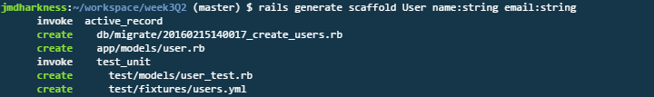
Blog Example - Scaffolding
Use Scaffolding to create the Users database, Controller, View and Users Model.
Users
name:string
email:string
id:integer

Slide 23
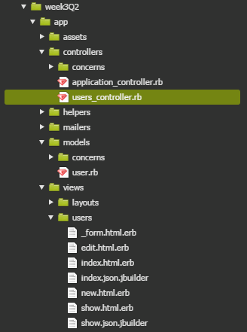
Blog Example – Output

Slide 24
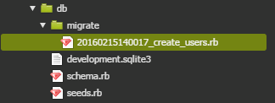

Blog Example – Migration File
Migration file can be found under: db\migrate.
Need to use rake db:migrate command to creaete model in db.
Notes:
Somethings might have to use:
$bundle exec rake db:migrate
Above command helps reduce chance of errors occuring.

Slide 25

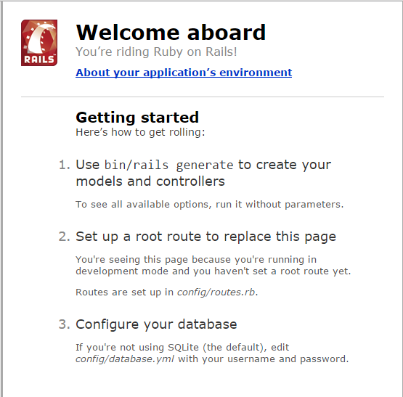
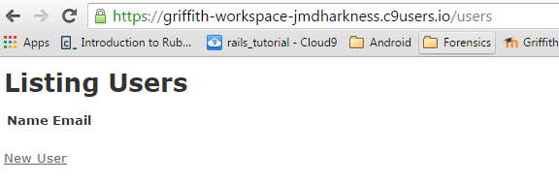
Blog Example – Run APP
Check App runs as expected.
Notes:
Above is example of REST in action.

Slide 26
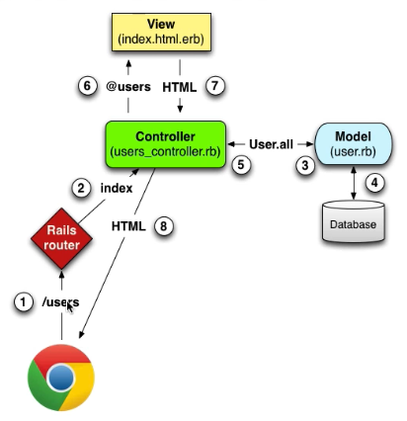
Blog Example – MVC Overview
https://www.railstutorial.org/book/toy_app
Notes:
How does the app work in relation to MVC

Slide 27
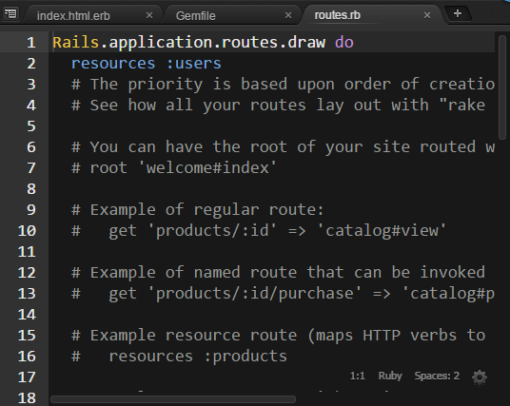
Blog Example – Routes.rb
Routes file adds new Resource users.
Notes:
Above is example of REST in action.

Slide 28
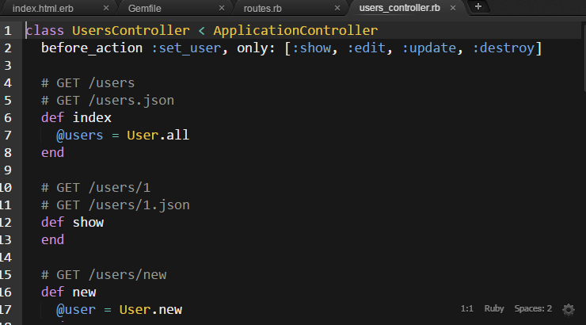
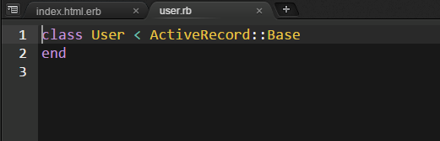
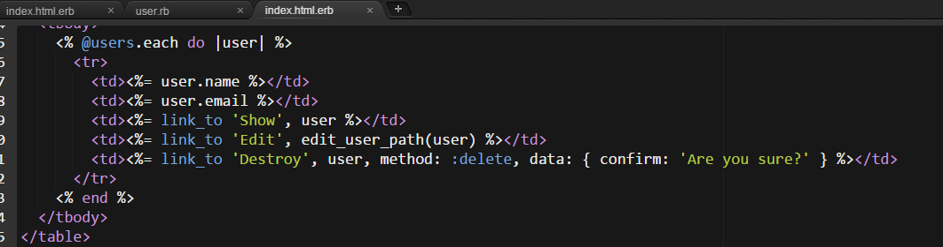
Blog Example – User Controller
Model
Controller
View
views\users\index.html.erb
Notes:
Show users_controller and the index action, @users=User.all (User.all is the user model) @users is an instance variable.
User model in users.rb file, under /models/. Not much in file, just inherits functionality from ActiveRecord:Base.
Show HTML vs Ruby code.
27. Code iterates through all users and displays them.
<% @users.each do |user| %>
<tr>
<td><%= user.name %></td>
<td><%= user.email %></td>
<td><%= link_to 'Show', user %></td>
<td><%= link_to 'Edit', edit_user_path(user) %></td>
<td><%= link_to 'Destroy', user, method: :delete, data: {confirm: "Are you sure"'} %></td>
</tr>
<% end %>

Slide 29
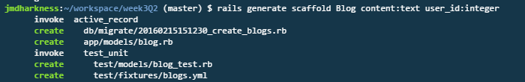
Blog Example - Blog
Use Scaffolding to create the Blog table, Controller, View and Users Model.
Blogpost
content:text
user_id:integer
id:integer

Slide 30
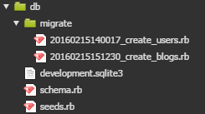

Blog Example – Migration File
New Migration file can be found under: db\migrate.
Need to use rake db:migrate command to create model in db.
Notes:
Somethings might have to use:
$bundle exec rake db:migrate
Above command helps reduce chance of errors occuring.

Slide 31
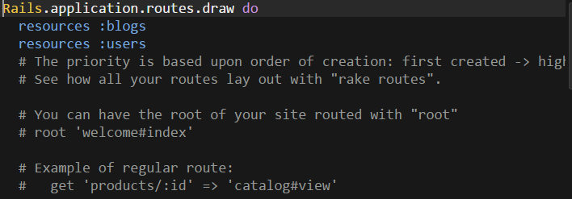
Blog Example – Routes.rb
As before, there is a new Resource in the Routes.rb file:
Notes:
Above is example of REST in action.

Slide 32
Blog Example – Character Limit
We can set some validations across the data if we want. For example, what if we wanted to limit how big a post could be?
In the Blog.rb file, we could add something like this:
validates :content, length: { maximum: 500 }
OR, if we want to have a min and max:
validates :content, length: { maximum: 500, minumum: 10 }
Notes:
Above is example of REST in action.

Slide 33

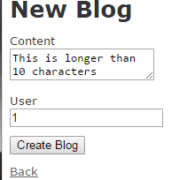
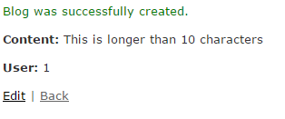
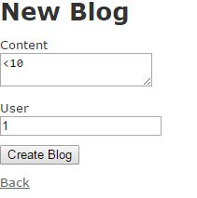
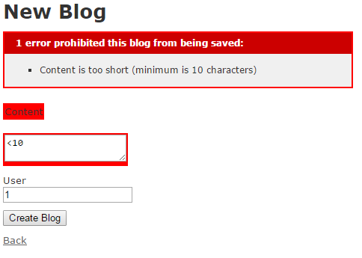
Blog Example – Character Limit
Notes:
Above is example of REST in action.

Slide 34
Blog Example – Relating DB
id | content | user_id
1 | Some Content | 1
2 | First Content | 2
3 | More Content | 1
id | name | email
1 | John | abc@o.ie
2 | Derek | efg@m.ie
3 | James | hij@l.ie
The above diagram states that a user can have many blogs (has_many)
The above also states that each blog, belongs to a particular user (belongs_to)
We need to reflect this in the User and Blog Model (ie: user.rb and blog.rb files)
Notes:
A user can have many Posts (has_many) . An each post, belongs to a user (belongs_to)

Slide 35
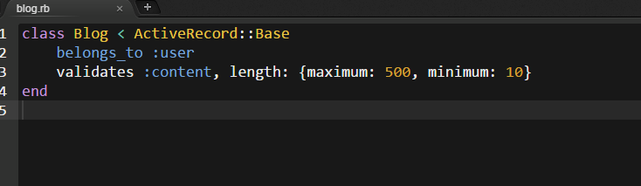
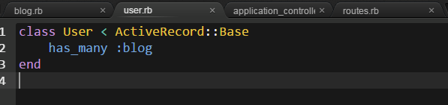
Blog Example – Relating DB
Notes:
A user can have many Posts (has_many) . An each post, belongs to a user (belongs_to)

Slide 36
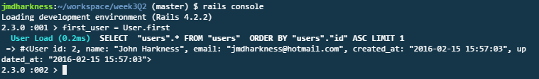

Blog Example – Rails Console
Use Rails Console to view DB and Relationship.
Can query fields such as name and email, but also related blog post.
Notes:
Notice ID is 2, not 1.

Slide 37
Blog Example – Limitations
The limitations of the App so far:
No Data Validation
No user verification
No Layout / Style
No Real understanding

Slide 38
Practical Q2
Follow the preceding slides to create your own Blog site.
Modify the code so that the first page that displays is not the default Ruby page, but instead the users page.
Put the code under version control, GIT, Bitbucket and upload to Heroku.
Before pushing to Heroku, be sure to use the following command:
$heroku run rake db:migrate
Notes:
Notice ID is 2, not 1.

